Slide 1
END ROGE DNA
Why Shadow DNA Identification Indexing Targets Black and Latinx Communities, Hurts Victims, and Does Not Reduce Crime
THE LEGAL AID SOCETY
APRIL 20, 2021
Black, Puerto Rican, Hispanic & Asian Legislative Caucus Presentation

Slide 3
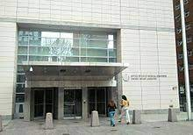
SAMPLE TYPE | APPROXIMATE NUMBER IN NYC’S ROGUE DNA INDEX
Total “Suspects” | 33,000
Surreptitiously Collected | 16,500
Collected from Children | 1,600-3,300
People Never Convicted of a Crime | 8,250
Total taken from BlPOC New Yorkers | ???????
ROGUE DNA BY THE NUMBERS

Slide 4
RACE BASED COLLECTION AND A REJECTION OF TRANSPARENCY AROUND RACE
COUNCIL MEMBER GIBSON: Do you have race and ethnicity, age?
CHIEF HARRISON: Council, Councilwoman, no, but, once again is this. Once, um, I was given the blessing to be in the position. I've taken a look at a couple things. That was kind of like my first question, well, what's the demographics. Um, I was a little disappointed that we didn't have that, and that's something that we're putting place as we speak right now regarding making sure that that's documented by the investigator that's taking these samples. So now if we have to share that information with the public, um, we're able to do that going into the future. So it's, it's a work in progress. I apologize that we don't have for you at this time, but I can reassure you going into the future we will have better answers going for you.

Slide 5
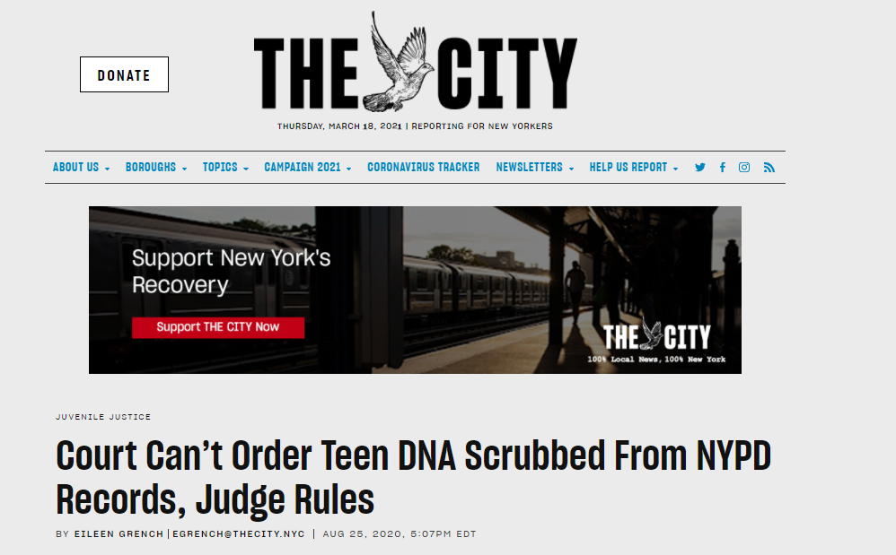
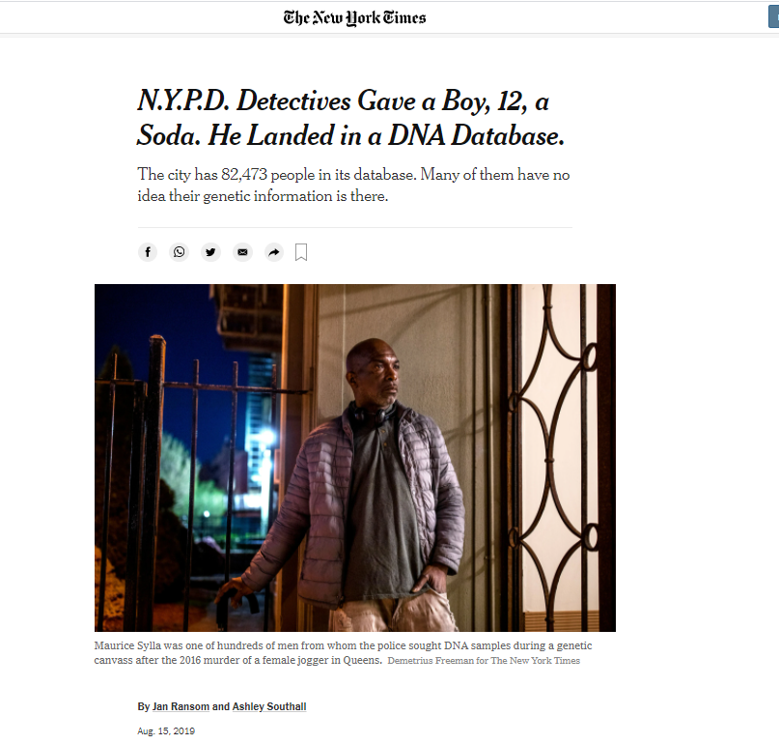
‘PERMANENT SUSPECTS’: BIPOC People in genetic purgatory

Slide 6
HOW NEW YORK CITY WENT ‘ROGUE’ ON DNA
Local “suspect” index

Slide 7
WHO IS IN THE NEW YORK STATE DNA IDENTIFICATION INDEX?
Who is in the State ID index?
Who is not in the State ID index?
People convicted of “Designated Offenses”
Designated offender” means a person convicted of any felony defined in any chapter of the laws of the state or any misdemeanor defined in the penal law except that where the person is convicted under section 221.10 of the penal law , only a person convicted under subdivision two of such section, or a person convicted under subdivision one of such section who stands previously convicted of any crime as defined in subdivision six of section 10.00 of the penal law .
People on probation or parole
People who are not convicted of crimes.
Arrestees
Children and youthful offenders
People who are exonerated or pardoned
People who were in the State index, but are later exonerated, pardoned, or adjudicated as a youth are automatically removed from the index.
Sources: Executive Law 995; et seq.

Slide 8
MR. REILLY: … I do see this as the last incremental step before we collect everybody's DNA using the same rationale that now we can catch the criminals. And law officers, all those in the judicial system, of course, would love to have everybody's DNA, and I've heard that suggested in this very Chamber.... [W]e've seen a steady incremental expansion of the database over the last seven years and, I believe, that collecting everybody's DNA is a very, very serious violation of our privacy rights.
MR. LENTOL: Well, if what you mean by “collecting everybody's DNA” you're talking about those people who are convicted of crimes, you are correct. That's not everybody in the world. It's everybody who[ has] been convicted of a crime.
***
MR. REILLY: My question is would you make a definitive statement here that you, as the sponsor of this legislation and, really, the father of this concept, that you will adamantly oppose any further expansion of the database?
MR. LENTOL: Yes.
NY Assembly Debate on A-9555, March 15, 2012 (emphasis added).

Slide 9
NYC’S Rogue DNA Index
More People
More Evidence
Anyone whose DNA is taken by the NYPD!
Children
People who are not suspects
Victims or witnesses
People who are never charged
People who are exonerated
What about race? NYPD collects this data, but, despite promises, has never shared it
Evidence that the FBI does not consider probative
Evidence from search warrants
Evidence collected directly from a person
Evidence that has fewer probative DNA markers

Slide 10
More People and More Evidence Puts NYC Last In The Nation
“By maintaining an unregulated DNA index that includes juveniles and people who have not been charged with or convicted of crimes, New York City holds the unfortunate distinction of having the least restricted and most expansive DNA identification index in the Country.” New York City Bar Association
Source: https://www.nycbar.org/member-and-career-services/committees/reports-listing/reports/detail/curbing-unregulated-local-dna-indexing

Slide 11
WHAT’S SO BAD ABOUT THIS?
“In addition to the ethical concerns, there are practical ones as well. We can only routinely look at a certain number of cases every day. A significant portion of our daily evidence examination, laboratory work, and report writing is dedicated to processing these “database only” samples of little to no evidentiary value. By lessening their number, we can literally free up slots in our daily case allotment that can be spent examining actual crime scene evidence and actual suspects in these crimes. “ –OCME Analysts

Slide 12
WHAT’S SO BAD ABOUT THIS?
People might wonder why an unregulated databank is such a concern. After all, they may say, “if a person hasn’t done anything wrong, why should they worry about their DNA?”
I tell them that a match alone these days does not mean a person is guilty of a crime. The more sensitive testing becomes, and the more people who are compared, the more potential there is for wrongful hits, like Terrell Gills, who was prosecuted for a robbery he did not commit based on an erroneous DNA match. Unregulated databanks also have more potential for error. An example is Darrell Harris, who was wrongfully arrested based on a “hit” to the OCME databank that was caused by lab contamination.
And DNA technology is ever evolving. Emerging technologies test people’s DNA for ancestry, diseases, and even psychiatric conditions. Given the vast and growing number of samples in OCME’s index, it is easy to imagine a databank that tracks people by any or all of these categories.
Source: https://www.nydailynews.com/new-york/nyc-crime/ny-dna-pioneer-criticizes-nypd-20200224-brwloofnrfapzhn332kvyzl23y-story.html

Slide 13
WHAT’S SO BAD ABOUT THIS?
One important group has stayed out of New York’s growing database: rank-and-file police officers. Though some forensic experts say it would be best to keep all officer profiles on file to eliminate their DNA when it winds up at crime scenes, only crime scene specialists, police lab employees, and bomb squad officers provide DNA. “Contractually police officers are not required to give DNA samples,” an NYPD spokesman said in an e-mail.
Source: https://www.thetrace.org/2017/09/new-york-city-gun-crime-dna-database/

Slide 14
What does S01347/A06124 do to fix this problem?
Closes loophole to make clear there is only a State DNA index

Slide 15
What does S01347/A06124 do to fix this problem?
Makes clear that only people who violated the social compact have to give their DNA to the government.

Slide 16
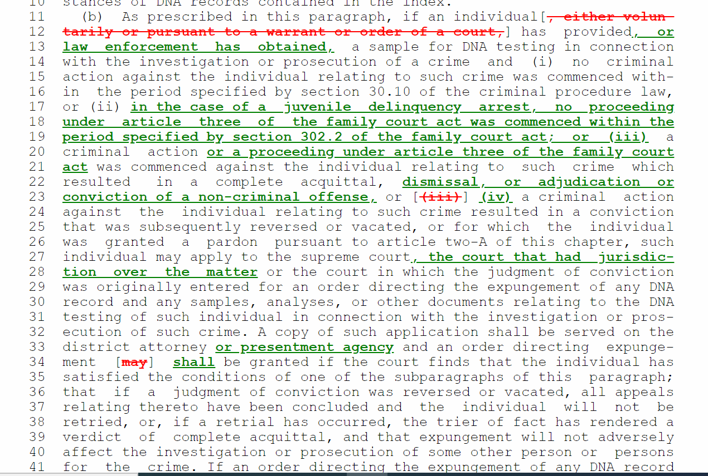
What does S01347/A06124 do to fix this problem?
Provides a pathway for juvenile expungement

Slide 17
What does S01347/A06124 do to fix this problem?
Closes loophole to make clear that local identification indexing is not allowed

Slide 18
What does S01347/A06124 do to fix this problem?
Removes DNA from individuals in identification index only

